Slide 1
DESIGN AND ANALYSIS OF ALGORITHMS
UNIT II
Disjoint Sets operations
Union and Find algorithms
AND/OR Graphs
Connected Components and spanning Trees
Backtracking- General Method
8-queens problem
Sum of Subsets problem
Graph Coloring problems
Hamiltonian Cycles

Slide 2
Disjoint Sets operations
Disjoint Sets
For any given set S= {S₁ ….. S_{k} }, partitioning the set into subsets with a condition of separate and non-overlapping of elements.
Example:
S= { 1,2,3,4,5,6}
S1 = { 1,2,3} S2= {4,5,6} S3= {1,3,5,} S4 = { 2,4,6}

Slide 3


Disjoint-Set Data-Type and Operations
Primary Operations:
MAKE-SET(x):
FIND-SET(x):
UNION(x, y):
create a new set containing only element x
return a canonical element in the set containing x
replace the sets containing x and y with their union
Performance parameters:
m = number of calls to FIND-SET and UNION operations
n = number of elements = number of calls to MAKE-SET
disjoint sets = connected components
Application: Dynamic connectivity over initially empty graph
(1 MAKE-SET operation)
(1 UNION operation)
(2 FIND-SET operations)
ADD-NODE(u): add node u
ADD-EDGE(u, v): add an edge between nodes u and v
IS-CONNECTED(u, v): is there a path between u and v ?

Slide 4
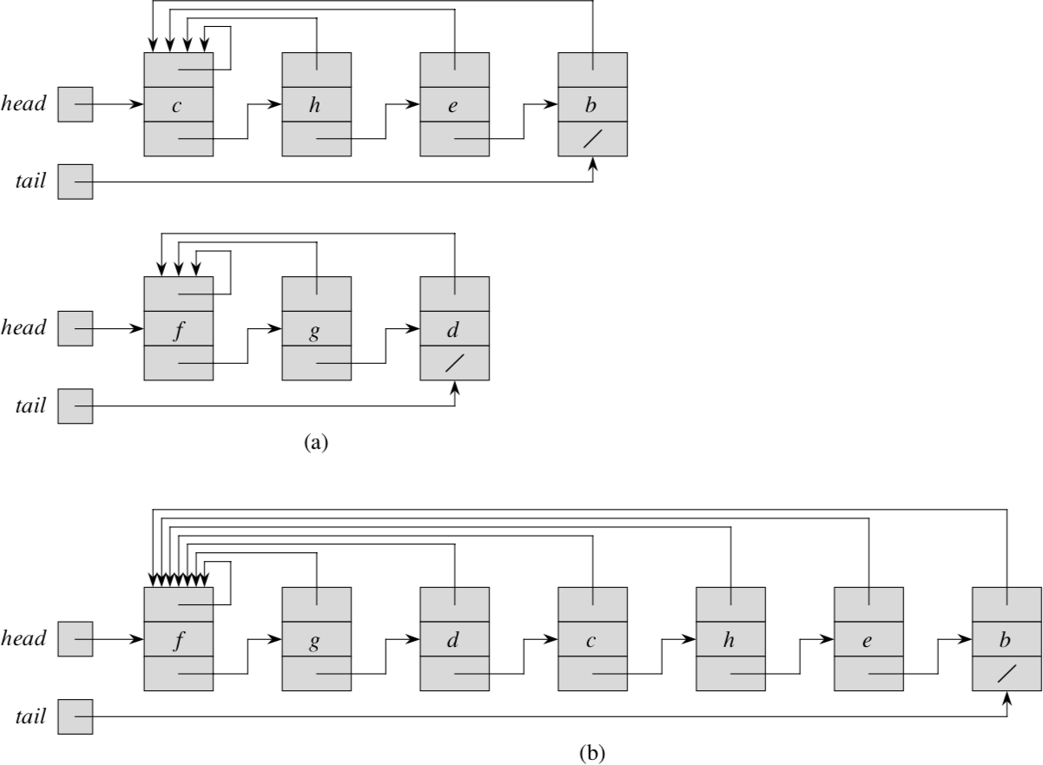
Disjoint-Set Operations: Implementation (1-Linked List)
MAKE-SET(x): O(1)
need to create only one node created with appropriate pointers
Set A: {c, h ,e, b}
FIND-SET(x): O(n)
need to traverse entire linked list to find x
Set B: {f, g, d}
Set (A U B): {c, h, e, b, f, g, d}
UNION(x,y): O(n)
need to point back all back-pointers of second list to head of first list

Slide 5
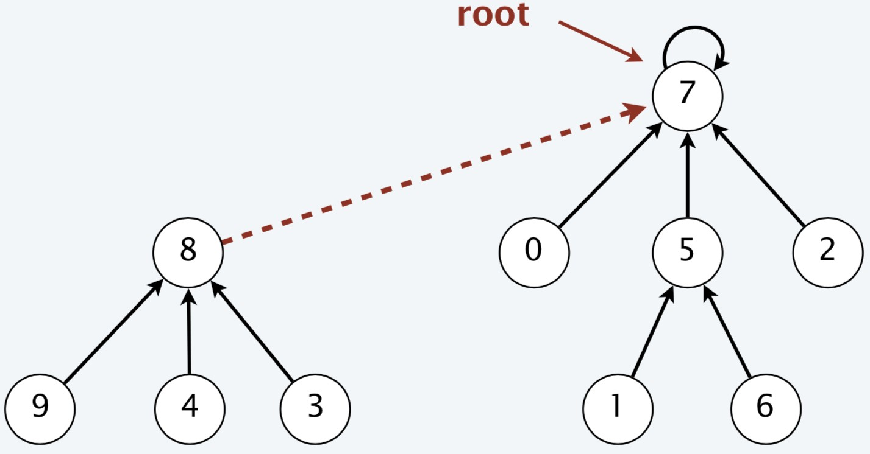
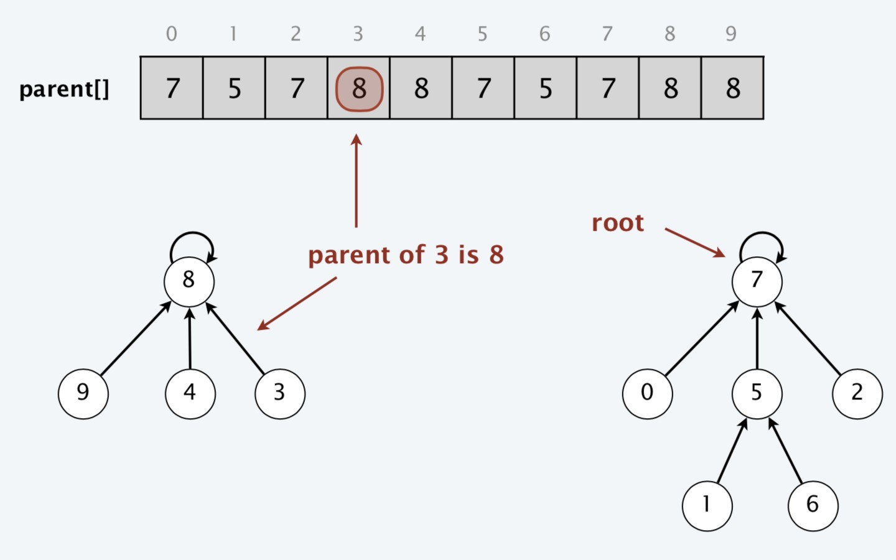

Disjoint-Set Operations: Implementation (2-Array )
Represent each set as tree of elements
Allocate an array of parent[] of length n
parent[i]=j (parent of element i is j)
UNION(3,5) or UNION(8,6) or UNION(8,7)
/ /
0 0
Analysis of Operations:
Total zeros in array = Disjoint-sets
FIND-SET(x): O(n) worst-case
X
X
UNION(x,y): O(n) worst-case
UNION(FIND-SET(x), FIND-SET(y))
O(n) due to FIND-SET operation

Slide 6
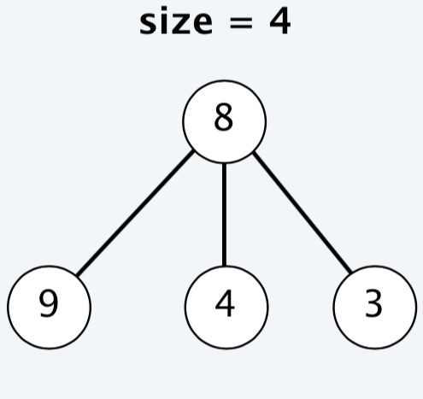
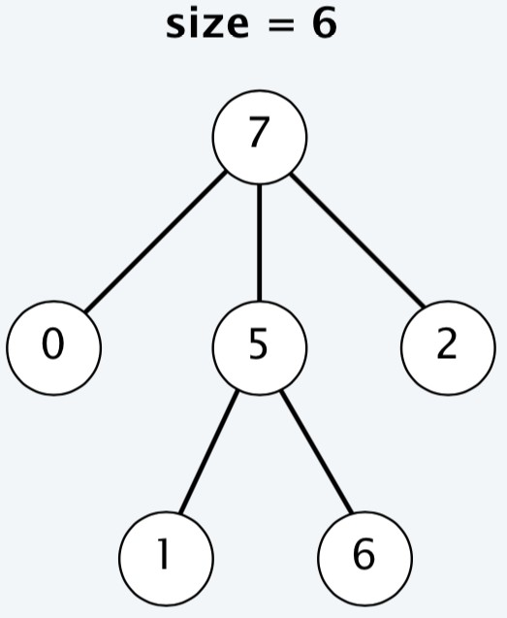
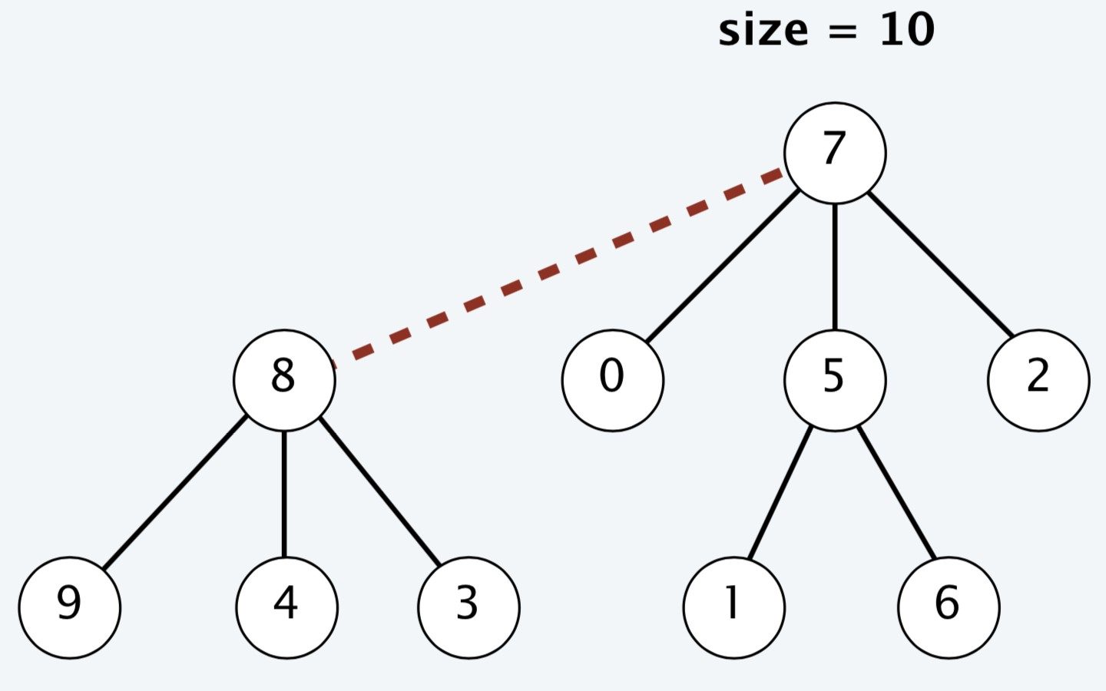
Smart Disjoint-Set Operations: Union-by-Size
Union-by-Size
UNION(x,y) {
r ← FIND-SET(x); s ← FIND-SET(y);
if(r == s) return r;
else if(size[r] > size[s]) {
parent[s] ← r;
size[r] = size[r] + size[s]; return r;
}
else {
parent[r] ← s;
size[s] = size[r] + size[s]; return s;
}
}
Maintain a tree size (number of nodes) for each root node
Link root of smaller tree to root of larger tree (break tries arbitrarily)
FIND-SET(x) {
While (x is not parent)
x ←parent[x];
Return x;
}
UNION(3,5)
MAKE-SET(x) {
parent[x] ← 0;
Size[x] ← 1;
Return x;
}

Slide 7
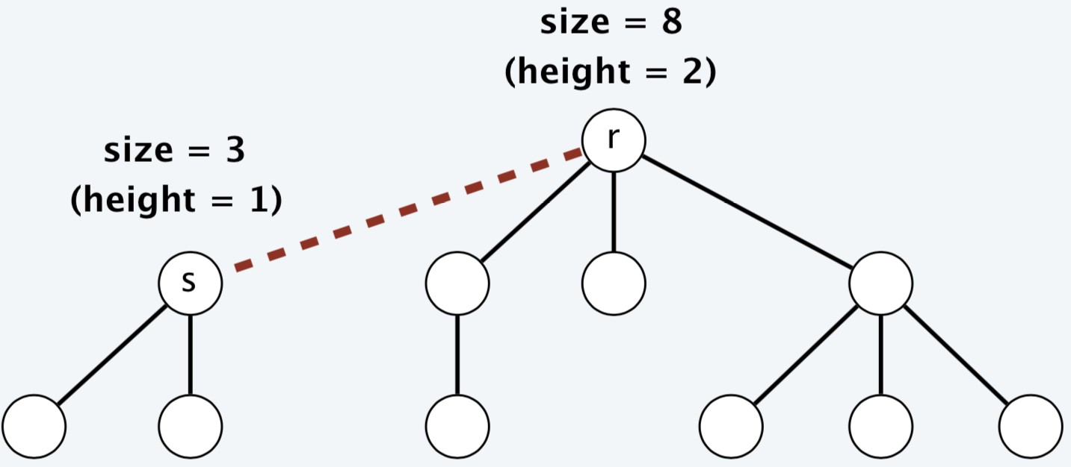


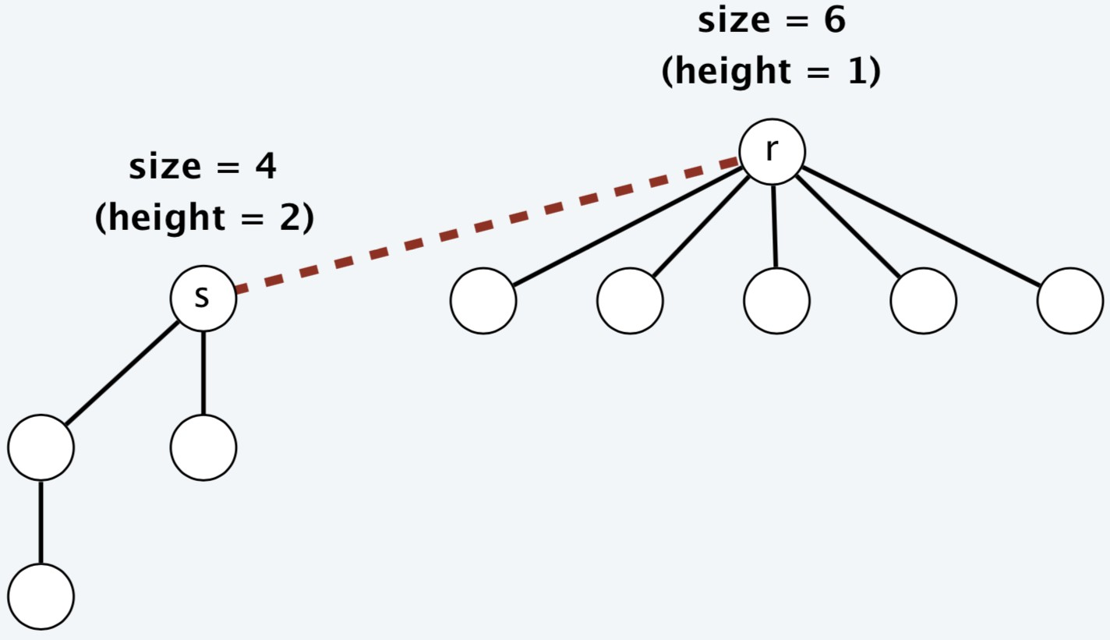


Analysis of Union-by-Size Heuristic (1)
Property: Using union-by-size, for every root node r, we have size[r] ≥ 2^{height(r)}
Proof:
by induction on number of links
Base case: singleton tree has size 1 and height 0
Inductive hypothesis: assume true after first i links
Tree rooted at r changes only when a smaller (or equal) size tree rooted at s is linked into r
Case 1. [ height(r) > height(s) ]
sizeʹ[r] > size[r] ≥ 2^{height(r)} = 2^{heightʹ(r)}
Case 2. [ height(r) ≤ height(s) ]
sizeʹ[r] = size[r] + size[s] ≥ 2 size[s] ≥ 2 x 2^{height(s)}
₌ ₂height(s) + 1 ₌ ₂heightʹ(r)

Slide 8
Analysis of Union-by-Size Heuristic (2)
Theorem: Using union-by-size, any UNION or FIND-SET operation takes O(log₂ n) time in the worst case, where n is the number of elements
Proof:
The running time of each operation is bounded by the tree height
Using union-by-size, a tree with n nodes can have height at most log₂ n
By the previous property, the height is ≤ [log₂ n]
The UNION operation takes O(1) time except for its two calls to FIND-SET
FIND-SET required to find out the set representative (which is the root)
m number of UNION and FIND-SET operations takes a total of O(m log₂ n) time

Slide 9
AND/OR GRAPHS
Technique for solving problems that can be decomposed into sub problems
Links between nodes indicates relations between problems
Or node: one of its successor node has to be solved
And node: all of its successor node has to be solved
Problem can be specified by two thinks: start node, goal nodes.
Goal nodes: trivial (or primitive) problems
Cost can be attached to arcs or nodes

Slide 10
A A
A’ A”
B C D E
B C D E
Terminal nodes AND node OR node
(a) (b)
Figure.2.9: AND/OR graphs representing problems
Terminal node represent primitive problems and are marked either solvable or not solvable. Solvable terminal nodes are represented by rectangles.
An AND/OR graph need not be always a tree.

Slide 11
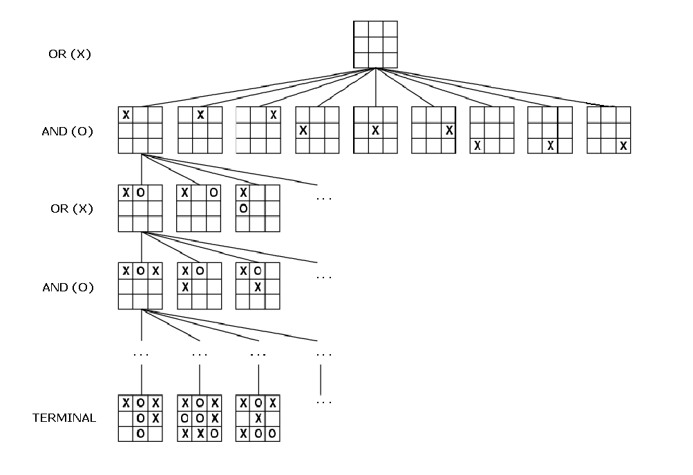
AND/OR GRAPHS
TIC-TAC-TOE PROBLEM

Slide 12
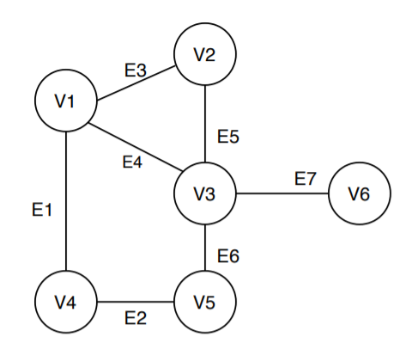
Connected component for an undirected graph
A connected component for an undirected graph is a subgraph in which each pair of nodes is connected with each other via a path
Consider a graph G=(V,E) where V represents the vertices of the graph and E represents the edges of the graph.
V= {v₁,v₂,v₃,v₄,v₅,v₆}; E= {e₁,e₂,e₃,e₄,e₅,e₆,e₇}
The graph given in fig represents a single connected component

Slide 13
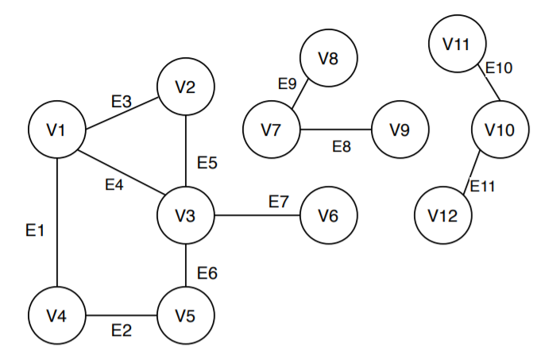
Connected component for an undirected graph
The graphs in the fig represents a single graph with two more subgraphs.
The subgraphs are referred as connected components.
C2
C3
C1

Slide 14
Algorithm: to find connected components
Component_count = 0;
For each vertex k € V do
Visted[k] = False;
End
For each vertex k € V do
If visted[k] == false then
DFS(V,k);
Component_count = Component_count + 1;
End
End
Print Component_Count;
Procedure DFS(V,k)
Visted [k] = true;
For each vertex p € V.Adj[k] do
If Visted[p] == false then
DFS (V,p);
End
End

Slide 15
Connected component for an undirected graph
Time complexity Analysis
The algorithm counts the connected components for an undirected graph using DFS approach and counts the number of calls to the DFS function.
If the graph is represented by a adjacency list then the DFS phenomenon states that all the vertices are visited once, and each edge is visited twice. Thus the total time taken by the algorithm is O(V+E)
If the graph is represented by the adjacency matrix, using the DFS approach; which traverse the entire row to evaluate the neighbor vertices, the total time taken by the algorithm will be O(V²)

Slide 16
BACKTRACKING –GENERAL METHOD
General Method
Problems searching for a set of solutions or which require an optimal solution can be solved using the backtracking method.
To apply the backtrack method, the solution must be expressible, as an n-tuple (x₁,x₂, …. , x_{n}) where x_{i}, are chosen for some set s_{i}.
The solution vector must satisfy the criterion function P(x₁,x₂, …. , x_{n})
The criteria function involves two types of constraints called Explicit Constraint and implicit constraint.

Slide 17
BACKTRACKING –GENERAL METHOD
Explict Constraint: these are the rules that restrict each xi to take on values only from a given set.
Example: x_{i} >= 0; { a set of all non negative numbers}
Example to understand is 8-queen problem
Implicit constraint: The implicit constraint are the rules that determine which of the tuples in the solution space satisfy the criteria function. i.e., it describes the way in which x_{i}, must relate to each other.
l_{i}<= x_{i} <= u_{i}
Example to understand is sum of subsets problem.

Slide 18
8-QUEEN PROBLEM
Given a NXN matrix find a way to place n queens such that no queen can attack any other queen. A queen said to be attacked only if the two queen lie in a same row or column or diagonal.
The explicit constraint it is restricted to a set of { 1,2,3,4}
Q1 is placed in the column (1,1)
Q1
Q1
 |  | Q2
Q2 is placed in (2,3), but the next queen Q3 cannot be placed we need to backtrack and change the position of Q1

Slide 19
8-QUEEN PROBLEM
 | Q1
Q1 is placed in the column (1,2)
 | Q1
 |  |  | Q2
Q3
 |  | Q4
Subsequently place the second queen following the rules, third queen and fourth queen to obtain a feasible solution.

Slide 20
8-QUEEN PROBLEM
Algorithm:
START
Begin from the left most column
If all the queens are placed,
return true and print
3. Check for all rows in the current column
a) if queen is placed safely, mark row and column, and recursively check if the current position is yielding to a solution or not
b) if the placing yields a solution return true,
c) if placing does not yield a solution, unmark and try another rows.
4. If all rows tried and solution not obtained, return false and back track.
END

Slide 21
8-QUEEN PROBLEM
Time Complexity Analysis
The initial step takes O(n) time
Following each placement will take O(n) time, and subsequently the backtrack will lead to the recurrence relation
Therefore adding recurrence relation to the the total time taken is
T(n) = O(n^2) + n * T(n-1)
Solving this relation we get O(N!)

Slide 22
Sum of subsets
Sum of Subsets problem is stated as
For a given set of n distinct positive numbers, find all the possible subsets whose sum individually should be m.
Explicit Constraints
x_{i} Є { j | j is an integer and 1 ≤ j ≤ n}
Implicit Constraints:
The sum of the corresponding w_{i}’s is m
No two x_{i} can be similar
x_{i} < x_{i+1} to avoid generating multiple instances.

Slide 23
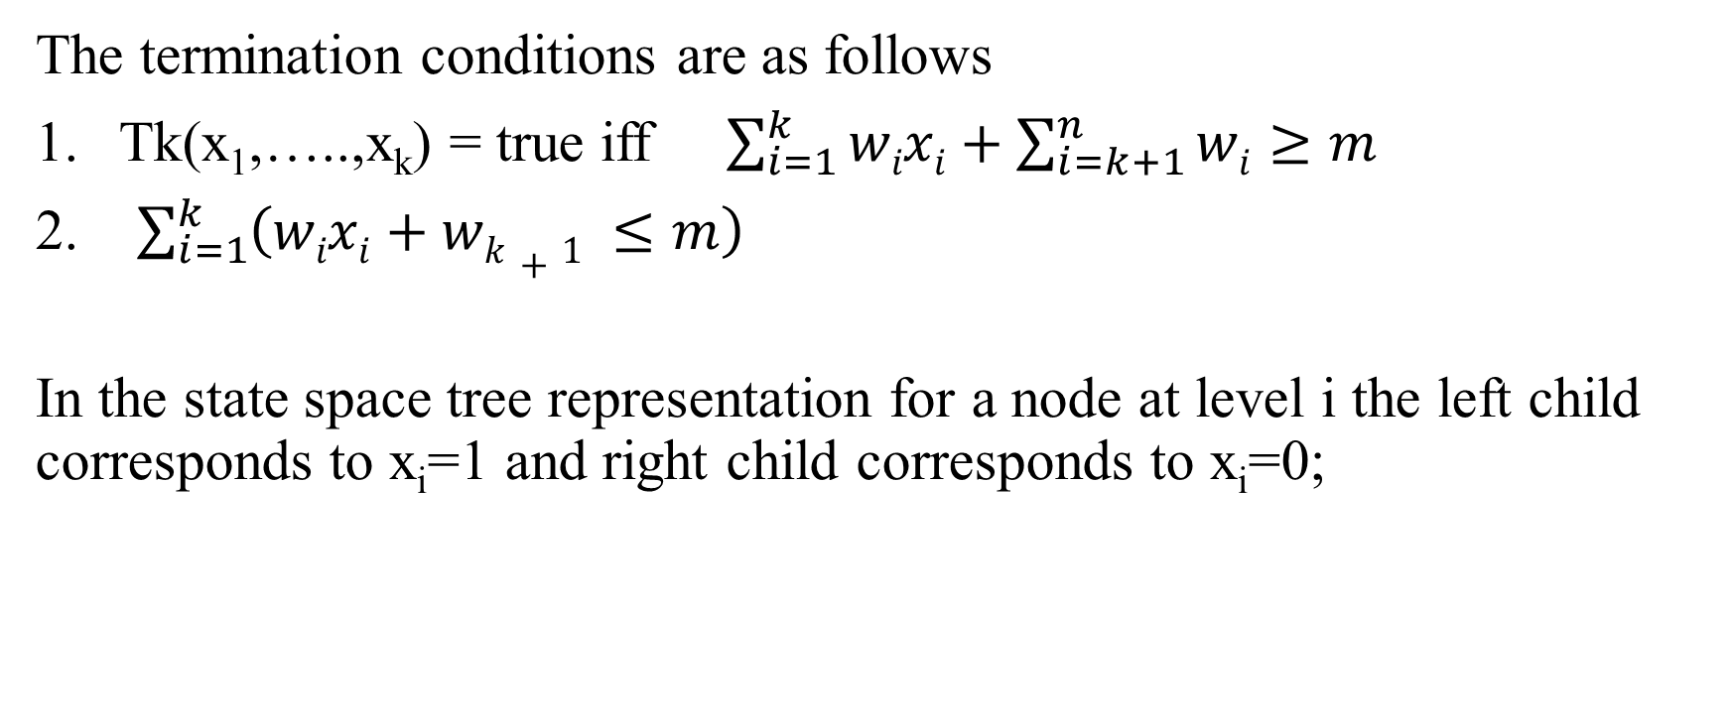
Sum of subsets
The termination conditions are as follows
Tk(x₁,…..,x_{k}) = true iff $\sum_{i=1}^{k}{wixi+\sum_{i=k+1}^{n}{wi≥m}}$
2. $\sum_{i=1}^{k}{\left(wixi+wk+1 ≤m\right)}$
In the state space tree representation for a node at level i the left child corresponds to x_{i}=1 and right child corresponds to x_{i}=0;

Slide 24
Sum of subsets
Algorithm
Sumofsubset(s,k,r)
{
X[k]=1;
If (s+W[k]=m then write )X[1:k]);
Else if (s+W[k]+W[k+1]<=m)
Then sumofsubets(s+W[k],k+1,r-W[k]);
If ((s+r-W[k]>=m)and(s+W[k+1]<=m)) then
{
X[k]=0;

Slide 25
Sum of subsets
Example to solve the following problem set of elements ={5,10,12,13,15,18} and m=30;
2
2
2

Slide 26
GRAPH COLORING PROBLEMS
The phenomenon of Graph Coloring was introduced to reduce the effort of printing maps with different colors.
Graph coloring problem is a classical combination problem. A graph G with n nodes and a positive integer m are given.
Using m colors only, to color all the nodes of graph G in such a way that no two adjacent node have the same color.
This problem is called the m coloring decision problem.
The integer m is called the chromatic number of the graph.

Slide 27
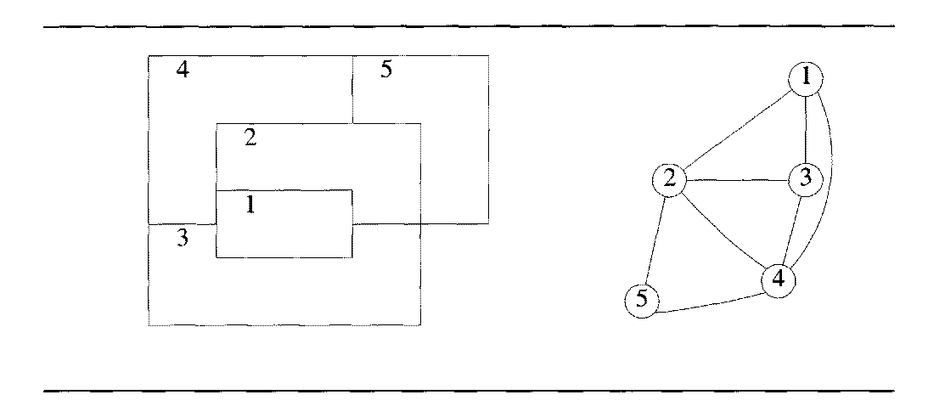
GRAPH COLORING PROBLEMS
A map and it’s planar graph representation

Slide 28
GRAPH COLORING PROBLEMS
Algorithm : Graphcolor(k)
// k is the next vertex node to be colored and G(V,E) is a connected graph //
//g is an adjacency matrix defined as 0 if (i,j) does not belong to E
1 if (i,j) belongs to E
// M is a chromatic number for G and initially it is 0, T is a list of distinct colors (1,2,3,..,m) and dead is a Boolean variable.
Dead = 0 // find all m color
While dead =0 do
through step 10 // find the next color

Slide 29
GRAPH COLORING PROBLEMS
3. x = 0
4. while x = 0 do ;Through 8
5. T[k]= T[k]+1 mod(m+1) // any color due
6. If T[k] = 0 then // all colors are used
x=1; return x
7. For j= 1 to n do // checking distinctness of colors
if g[k][j] ≠0 and T[k]=T[j] then ; x=1;exit
8. If j=n+1 then // consider new color//
x = 0; return x

Slide 30
GRAPH COLORING PROBLEMS
GRAPH COLORING PROBLEMS
9. If T[k] =0 then; Dead=0; return dead;
10. If k=n then; for r = 1to n do; write[k]
11 else
Graphcolor(k+1)
12. Return

Slide 31
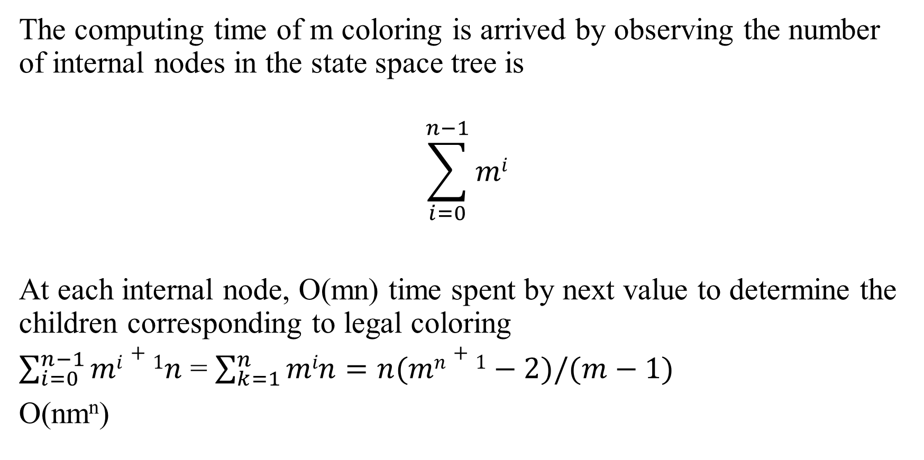
GRAPH COLORING PROBLEMS
The computing time of m coloring is arrived by observing the number of internal nodes in the state space tree is
$$\sum_{i=0}^{n−1}{mi}$$
At each internal node, O(mn) time spent by next value to determine the children corresponding to legal coloring
$\sum_{i=0}^{n−1}{mi+1n}$ = $\sum_{k=1}^{n}{min=n(mn+1}−2)/(m−1)$
O(nm^{n})

Slide 32
HAMILTONIAN CYCLES
Def: Let G = (V, E) be a connected graph with n vertices. A Hamiltonian cycle (suggested by Sir William Hamilton)is a round-trip path along n edges of G that visits every vertex once and returns to its starting position. In other words if a Hamiltonian cycle begins at some vertex v₁ ∈ G and the vertices of G are visited in the order v₁, V₂, …,v_{n+1,} then the edges (v_{i}, v_{i+1}) are in E, 1 ≤ i ≤ n, and the v_{i} are distinct except for v₁ and v_{n+1} which are equal.
Hamiltonian cycles should not have an articulation points
Hamiltonian cycles should not have pendant vertices.
Hamiltonian cycles should not repeat on same paths.

Slide 33
HAMILTONIAN CYCLES
G1: contains Hamiltonian cycles G2: does not contain Hamiltonian cycles

Slide 34
Algorithm for Finding all Hamiltonian cycles
HAMILTONIAN CYCLES

Slide 35
Algorithm for Generating next vertex
HAMILTONIAN CYCLES

Slide 36
HAMILTONIAN CYCLES
Using ‘Next Value’ we can particularize the recursive backtracking schema to find all Hamiltonian cycles
This algorithm is started by first initializing the adjacency matrix G[1:n, 1:n], then setting x[2:n] to zero and x[1] to 1, and then executing Hamiltonian.

